Slide 1

AI AGENT FOR CHRONIC DISEASE MONITORING using ibm cloud
Presented By:
Bhavadharini g
IT(Data Science)
Kumaraguru College of Technology-

Slide 2

Background and Motivation
Chronic diseases like diabetes, hypertension, and heart conditions are major causes of illness and death globally, requiring continuous and effective management.
Traditional monitoring methods are limited by infrequent clinical visits and patient self-reporting, resulting in delayed detection of complications.
Advances in AI, wearables, and cloud computing enable real-time data analysis and personalized chronic care, motivating the development of an AI agent using IBM Cloud Lite and Granity for proactive health management.

Slide 3

Problem Statement
Chronic diseases like diabetes, hypertension, and heart conditions require constant monitoring, but current practices largely depend on periodic visits and subjective patient reports.
Lack of real-time data integration and timely analysis leads to delayed detection of complications, poor adherence to treatment plans, and increased hospitalizations.
There is a need for an AI-driven agent that leverages wearable devices, medical records, and patient inputs to continuously monitor health, detect early warning signs, and provide personalized interventions using IBM Cloud Lite and Granity platforms.

Slide 4

Project Objectives
Build an AI agent to monitor chronic diseases using data from wearables, medical records, and patient inputs in real-time.
Use IBM Cloud Lite and IBM Granity AI for secure, scalable predictive analytics and personalized health recommendations.
Improve patient outcomes by enabling early warning detection, medication reminders, and enhanced communication between patients and healthcare providers.

Slide 5

Technology Stack Overview
IBM Cloud Lite: Scalable, free-tier cloud platform for secure medical data storage and processing
IBM Granite AI: Advanced foundation model designed for healthcare reasoning and predictive analytics
Watsonx Platform: Supports agent orchestration, conversational health guidance, and real-time user engagement
LangGraph Framework with ReAct architecture: Enables intelligent conversational workflows and explainable AI reasoning
Support tools: EHR integration for clinical data, health device connectivity, Python Interpreter for data analysis, and secure APIs for external system integration

Slide 6

System Architecture & Workflow
Collects real-time health data from wearables, medical records, and patient inputs through secure APIs.
Uses IBM Cloud Lite for secure storage and IBM Granity for advanced predictive analysis and early warning detection.
Employs Watsonx.ai with LangGraph and ReAct for intelligent conversational AI and personalized patient-provider engagement.

Slide 7

Results and Impact
Enabled early detection of chronic disease complications through real-time monitoring and predictive analytics.
Improved patient adherence with personalized medication reminders and lifestyle guidance.
Reduced hospital visits and enhanced communication between patients and healthcare providers using AI-driven insights.

Slide 8
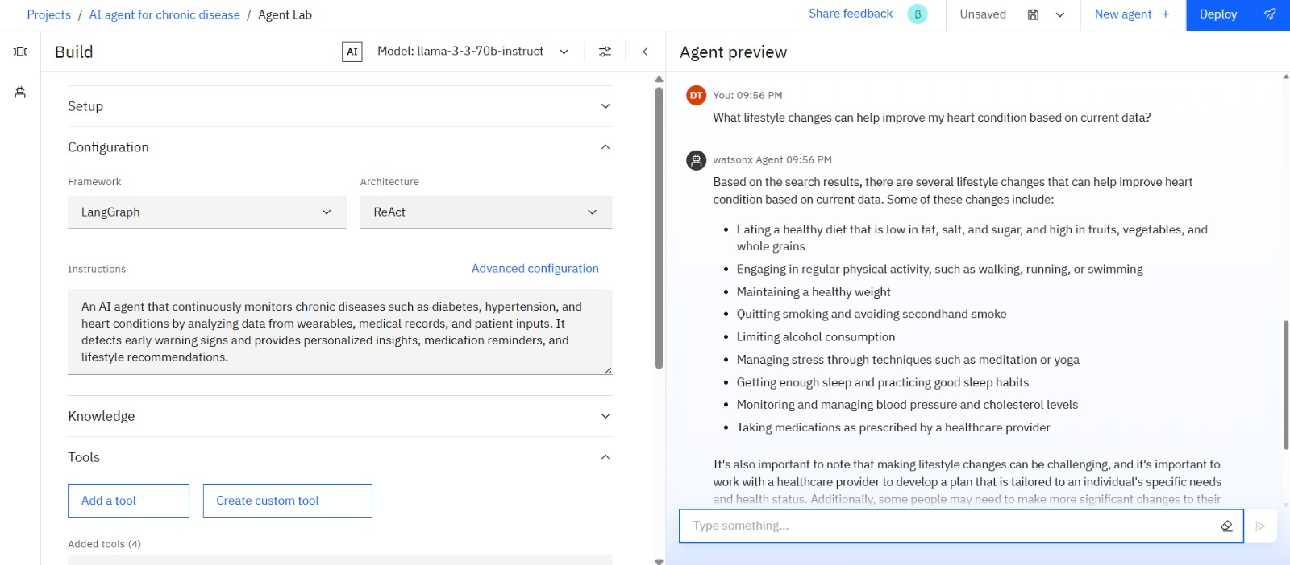
Result

Slide 9
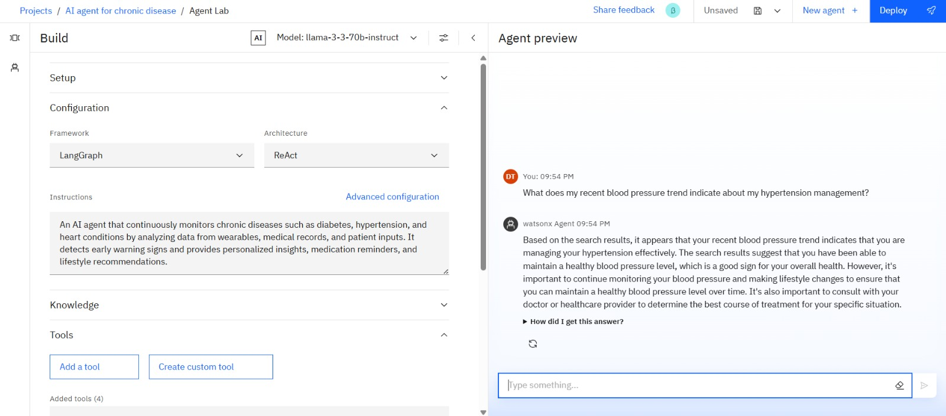
Result

Slide 10
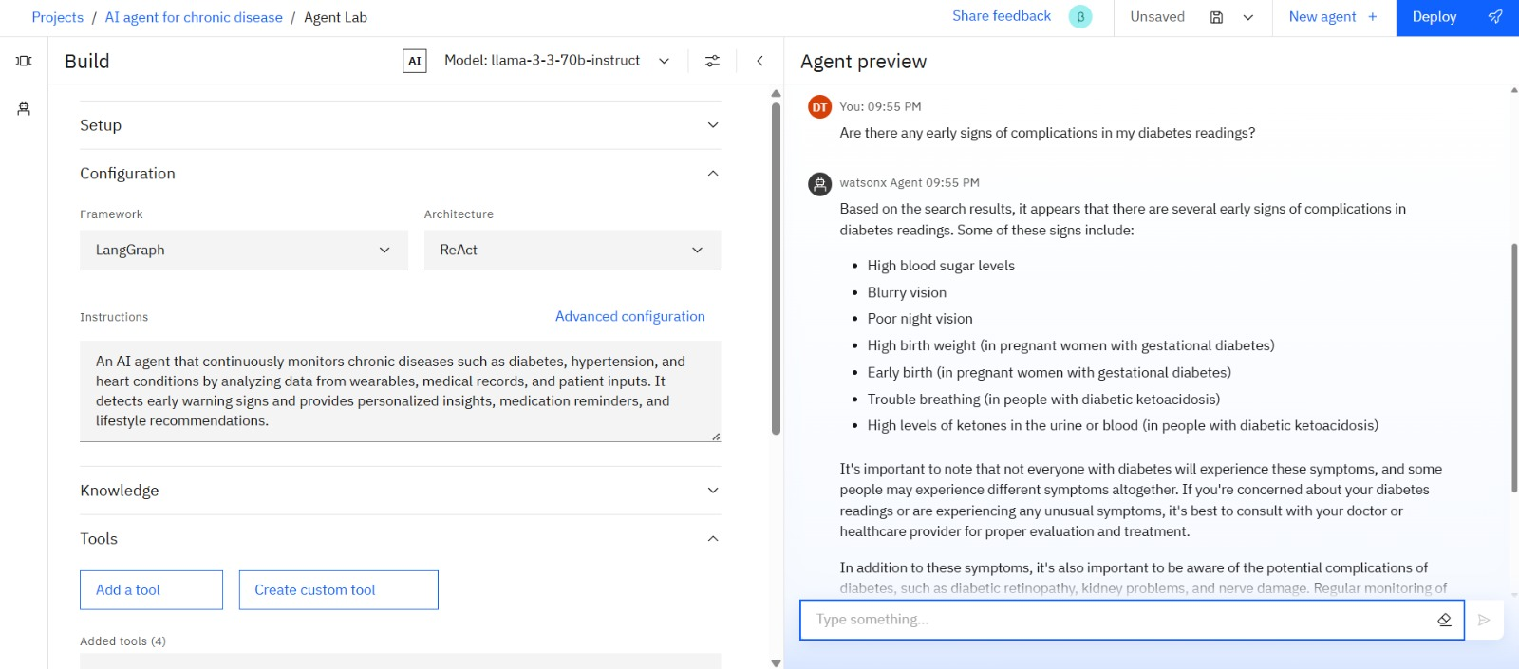
Result

Slide 11
Challenges and Resolutions
Data privacy and security: Addressed with encryption, access controls, and secure APIs on IBM Cloud.
Integration of diverse health data: Managed via standardized formats and modular pipelines.
Ensuring AI explainability: Used LangGraph and ReAct frameworks with ongoing model validation.

Slide 12
Future Work and Conclusion
Expand AI capabilities to include more chronic conditions and integrate multimodal data such as genetics and environment for comprehensive monitoring.
Enhance AI model explainability, fairness, and privacy through federated learning and bias mitigation for broader clinical adoption.
The project demonstrates AI’s transformative potential to shift chronic disease care towards proactive, personalized management, improving outcomes and reducing hospital visits using IBM Cloud Lite, Granity, and Watsonx.ai.

Slide 13
THANK YOU

